Slide 1
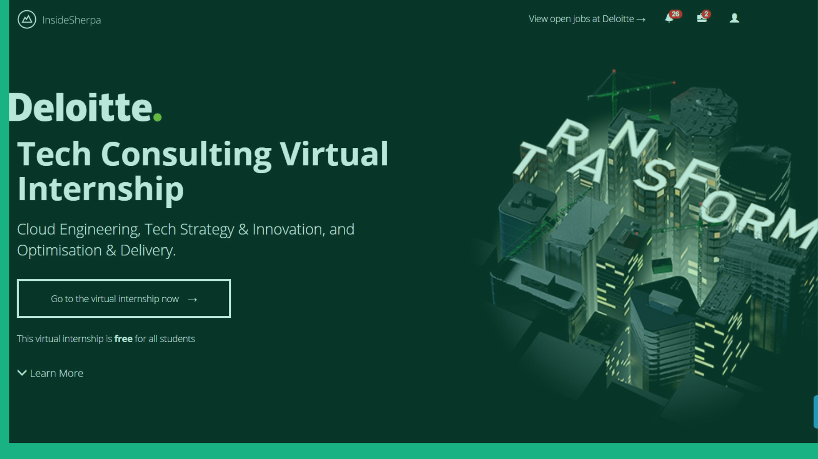

Slide 2
Agenda
The client has set up an initial meeting with Deloitte and has invited key stakeholders from both IT and the business. The objective of the meeting is to gain a deeper understanding of Cloud and assess if this aligns with their vision and technology portfolio.

Slide 3
Cloud Computing Definition
The process of utilizing the web application over the internet. It allows an online creation, configuration and customization of application
By using cloud computing users can access a specific data at any time around the world by using the internet connection. It helps the users in managing the data online.
In simple word, we can say it is a tool that use to store our data over the internet. The data can be our images, videos, GIF or any other text files. We can access the data any time from any part of the world by using an internet connection and your mobile or personal computer.

Slide 4
What does it mean to our client?
As we see in our daily life, a large companies have its own cloud solution (AWS, Google Cloud, Microsoft Azure). For any business it is important to keep the variable costs in control as per the demand for its products or services.
Example: Netflix is a business that requires IT infrastructure (computers, network, data center, bandwidth, etc.) to show movies to its subscribers. Or the number of subscribers connected to Netflix at a specific time.

Slide 5






Key Characteristics of the Cloud
Cost Effectiveness
Speed
Global Scale
Productivity
Performance
Reliability
Notes:
Cost: Cloud computing eliminates the capital expense of buying hardware and software and setting up and running on-site datacenters – the racks of servers, the round-the-clock electricity for power and colling, the IT experts for managing the infrastructure. It adds up fast.
Speed: Most cloud computing services are provided self-service and on demand, so even vast amounts of computing resources can be provisioned in minutes, typically with just a few mouse clicks, giving businesses a lot of flexibility and taking the pressure off capacity planning.
Global Scale: The benefits of cloud computing services include the ability to scale elastically. In could speak, that means delivering the right amount of IT resources – for example, more or less computing power, storage, bandwidth – right when its needed and from the right geographic location.
Productivity: on-site datacenters typically require a lot of “racking and stacking” – hardware set up, software patching and other time-consuming IT management chores. Cloud computing removes the need for many of these tasks, so IT teams can spend time on achieving more important business goals.
Performance: the biggest cloud computing services run on a worldwide network of secure datacenters, which are regularly upgraded to the latest generation of fast and efficient computing hardware. Ths offers several benefits over a single corporate datacenter, including reduced network latency for applications and greater economies of scale.
Reliability: cloud computing makes data backup, disaster recovery and business continuity easier and less expensive, because data can be mirrored at multiple redundant sites on the cloud provider’s network.

Slide 6
Cloud Capabilities
Institutions of higher learning foster a unique culture of collaboration across faulty, students and administrative staff, often in the face geographically-dispersed campuses. Today, nearly 70% of North American institutions of higher education have moved or are in the process of moving their admin systems to the cloud, and about 50% have adopted cloud-based collaboration systems to enhance the sharing of information across campus.

Slide 7
